Slide 1

TRAVEL MANAGEMENT SYSTEM
By
GUDDI YADAV
(B.Tech 3rd Year, Enrollment No.: 12019002001103 )
Under the Supervision of
Prof. Subrat Gautam
Dept. of Computer Science & Engineering
University of Engineering & Management, Jaipur

Slide 2
Outlines
Introduction
Literature Review
Objectives
Proposed Model
Experimental Setup
Result Analysis
Conclusion & Future Scope
Reference
Acknowledgement

Slide 3
Introduction
- This is “TRAVEL MANAGEMENT SYSTEM “ .
It is basically developed to helps travel managers book tickets,
View hotels, and book hotels.
- It is purely developed in Java framework Spring and MySQL.

Slide 4
Literature Review
The “Travel and Tourism management system” project purpose is to putting effort
To provide the right choice to the people when they plan a holiday and beware them from the false advertising. The other purpose of the project is also established fact that internet users are increasing today. So, the project is to facilitate the offline customer online because customer cannot spend their precious time in markets trying to find best deal.
Travel and Tourism Management looks to provide reservation facility to customers and it can be easy for them to search for hotels and book them and other travel staff.

Slide 5
Objectives
The main objective of the Travel Management System is to manage the travelling Services. This project developed tours and travel management system to provide a platform where tourist can find their hotels, tour places and also they can view their hotels and places and book that.
The purpose of the project is to build an application program to reduce the manual work for searching hotels, and searching tour places. Usually tourist don’t know about tour places, and hotels of that area so it’ll helps to provide these things in a one platform.

Slide 6
Proposed Model
The software “TRAVEL MANAGEMENT SYSTEM” is mainly focused on basic operations of a travel management system like
Check package with their all details( i.e. silver package , Gold package, Bronze package, half city tour, stay in five star ,full day , arrival drinks, horse riding, return airfare etc.)
Add, View, update personal details.
Check package, View details about package and book package.
View Hotels, book hotel, and view booked hotels.
Project show the slide of destinations.
Project have payment option, Calculator option, Notepad for making notes.

Slide 7
Experimental Set-up
- We used windows 10 , Apache NetBeans IDE 12.3., MySQL 8.0

Slide 8
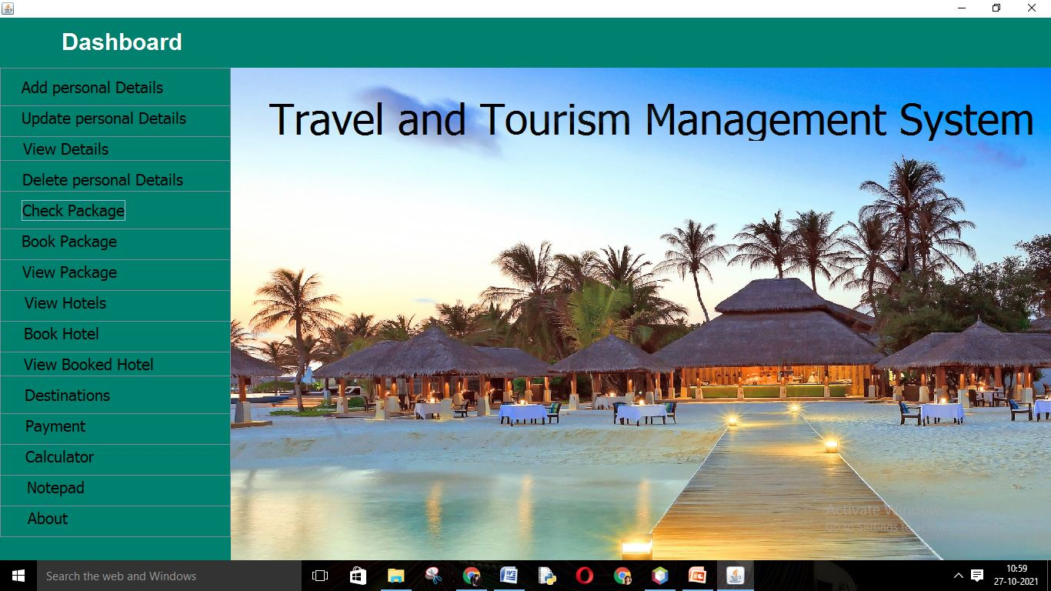
Result: Example

Slide 9
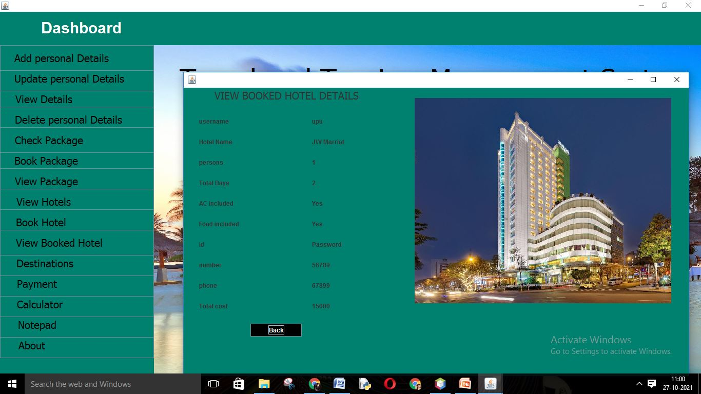
Result Analysis

Slide 10
Limitation
These are the Limitation of my Project:-
1.) It only contains few hotels and if user wants to book some other hotels beyond the list then It’s not possible.
2.) There is no option for choosing destination and that’s why some user find difficulty to choose their favourite destination.

Slide 11
Conclusions & Future Scope
Here I conclude my lines of my term paper on the topic ‘Travel and Tourism management system’ with the extreme with the extreme satisfaction and contentment.
Added to this my term and paper contain the basic description of Travel and Tourism management system using Java, Spring Framework, MySQL.
Any tourism group can use it for managing their hotels ,destinations, and their total cost of travel.
Reusability of this application is also possible.
This application can easily implemented under various situations.
Any tourist agency can make use of it for saving customers details in database.

Slide 12
References
Apache NetBeans IDE 12.3
MySQL 8.0 Command Line Client

Slide 13
Acknowledgement
I have taken efforts in this project. However, it would not have been possible
without the kind support and help of many individuals and organizations. I
would like to extend my sincere thanks to all of them.
I am highly indebted to (Prof. Subrat Gautham) for their guidance and constant
supervision as well as for providing necessary information regarding the project &
also for their support in completing the project.
I would like to express my gratitude towards my parents for their kind
co-operational encouragement which help me in completion of this project.
I would like to express my special gratitude and thanks to industry persons for
giving me such attention and time.
My thanks and appreciations also go to my colleague in developing the project
and people who have willingly helped me out with their ability.

Slide 14

Dept. of CSE, University of Engineering & Management Jaipur

